Slide 1


B9DA106: Data Visualization
Submitted by:
Student Name: Aniket Bachewar (10621078)
Prathamesh Jadhav (10621081)
Vaibhav Tiwari (10621051)
Lecturer Name: Kunwar Madan

Slide 2
Agenda : Task 1
Question 1
Tableau Visualizations
Waste management vs Geographical region
Waste management vs Population vs Urbanization index
Waste management vs Population density
Waste management vs Waste per km2
Average percentage of Plastic vs Metal vs Paper and Glass in waste management
Municipal solid waste that is sorted vs Municipal solid waste that is unsorted in waste management44
Waste management cost per capita vs Total Municipal solid waste (kg) vs Km of roads within the municipality
Matrix Visualization : PCA vs UMAP

Slide 3
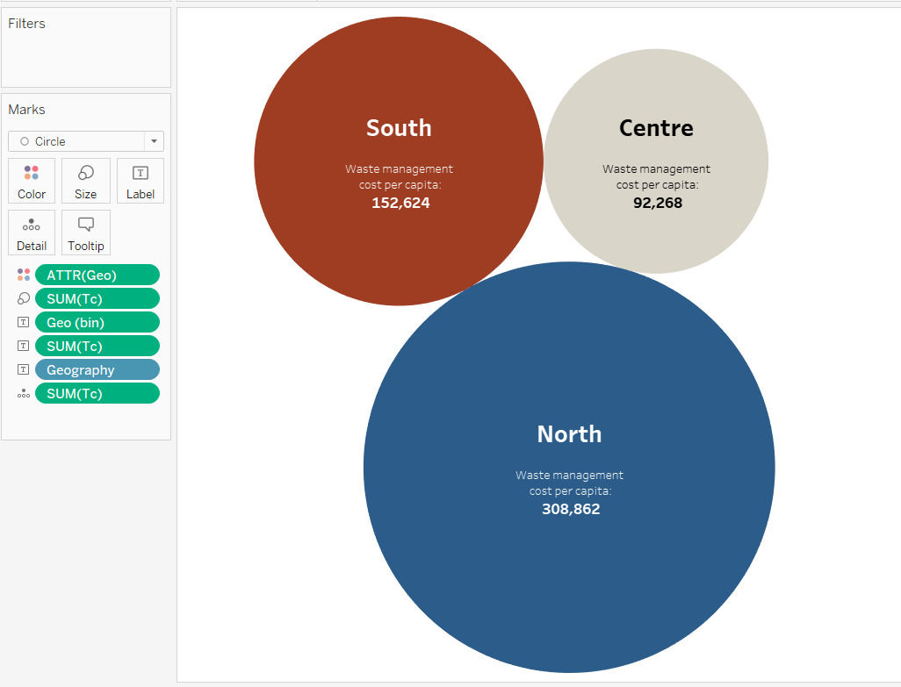
TC vs Geo
Waste management vs Geographical region
Describes the waste management cost per capita of each geographical region - Graph shows that the waste management cost is highest for north region and lowest for centre.

Slide 4
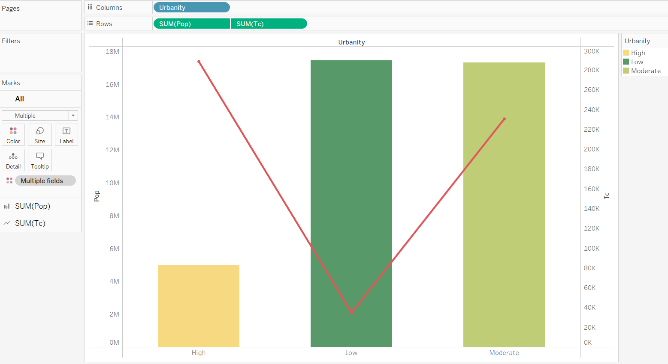
Tc vs Pop vs Urb
Waste management vs Population vs Urbanization index
The visualization represents Urbanity on X axis, Population and Waste Management cost per capita on Y axis where Population is bar graph and waste management is a line chart. Here, population and urbanity direct proportional.

Slide 5
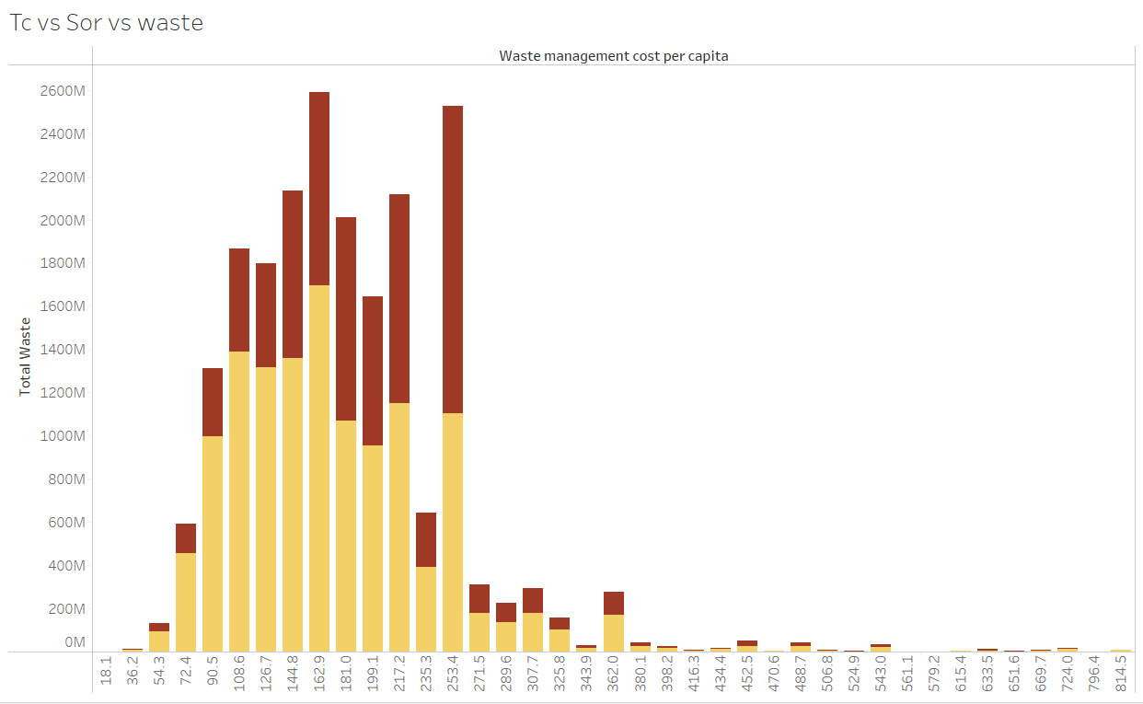
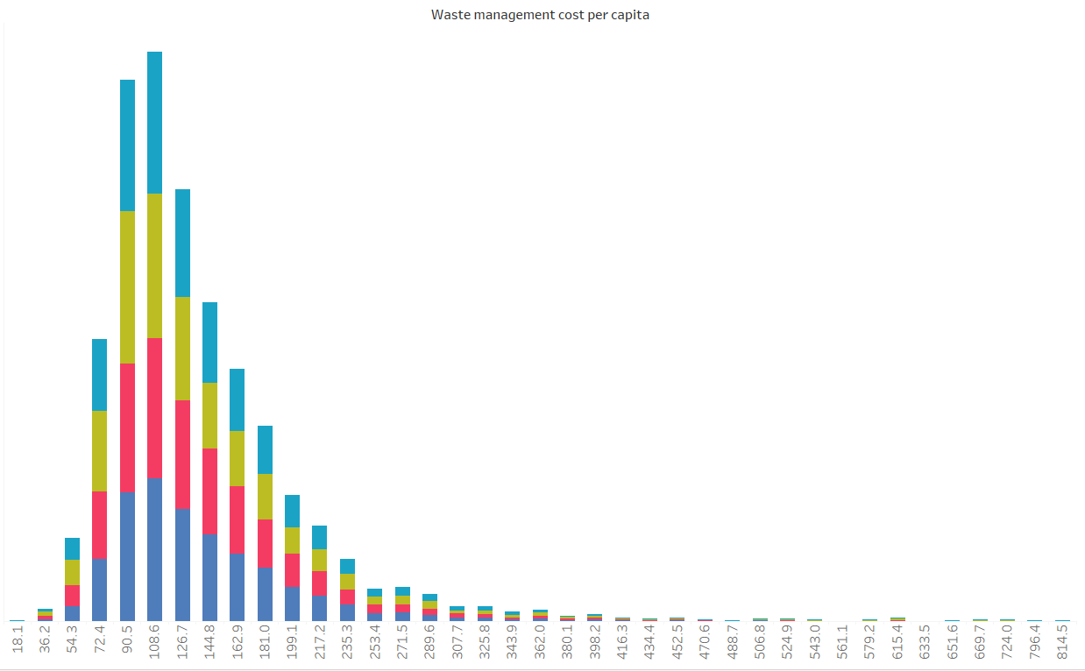
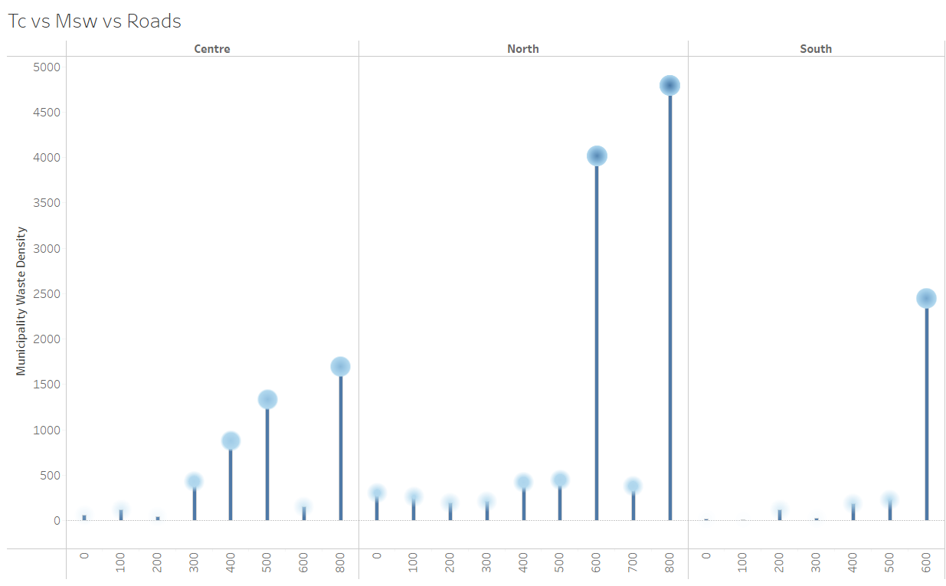
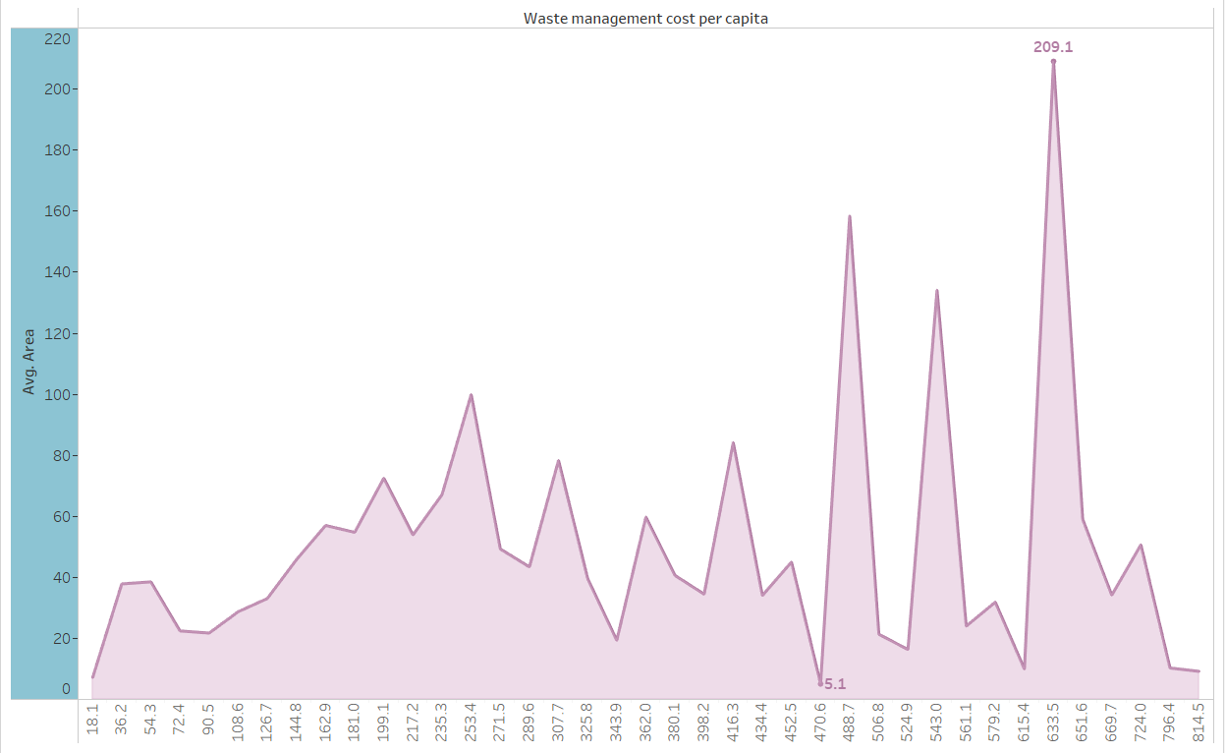
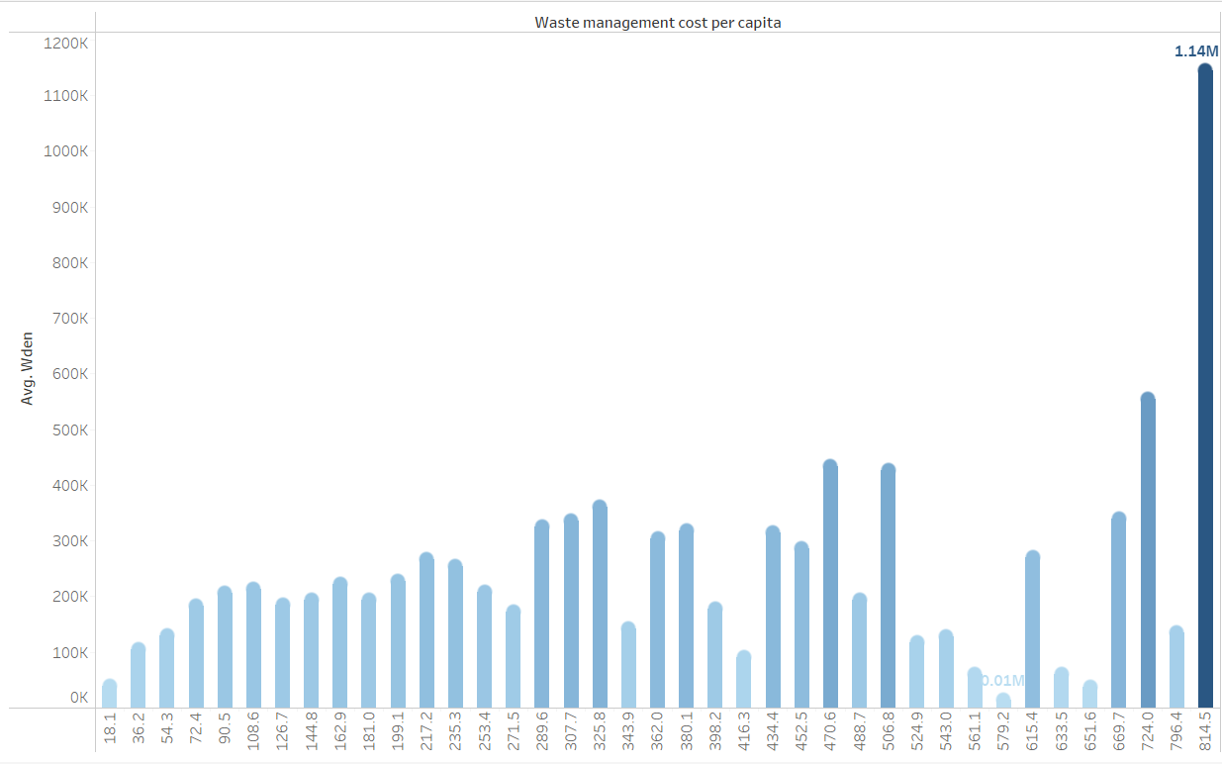
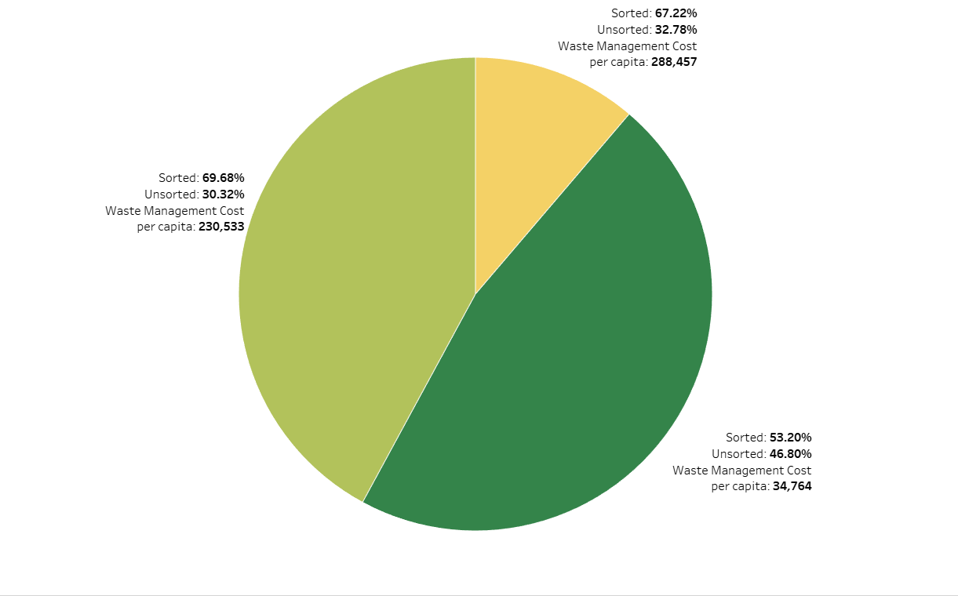
Tc vs population density and waste management parameters
The following graphs show waste management cost per capita against density and waste management parameters. We plotted Total cost per capita against various parameters like – the quantity of waste generated, the area under the municipalities and how the waste was sorted and generated. These parameters in general do not affect the Cost in general.

Slide 6
Learnings
We can conclude that urbanity and geography are the main factors to determine the waste management cost.
Increase in Area doesn’t affect the waste management cost.
All other parameters like how the waste was sorted also do not affect the per capita cost of waste management.

Slide 7
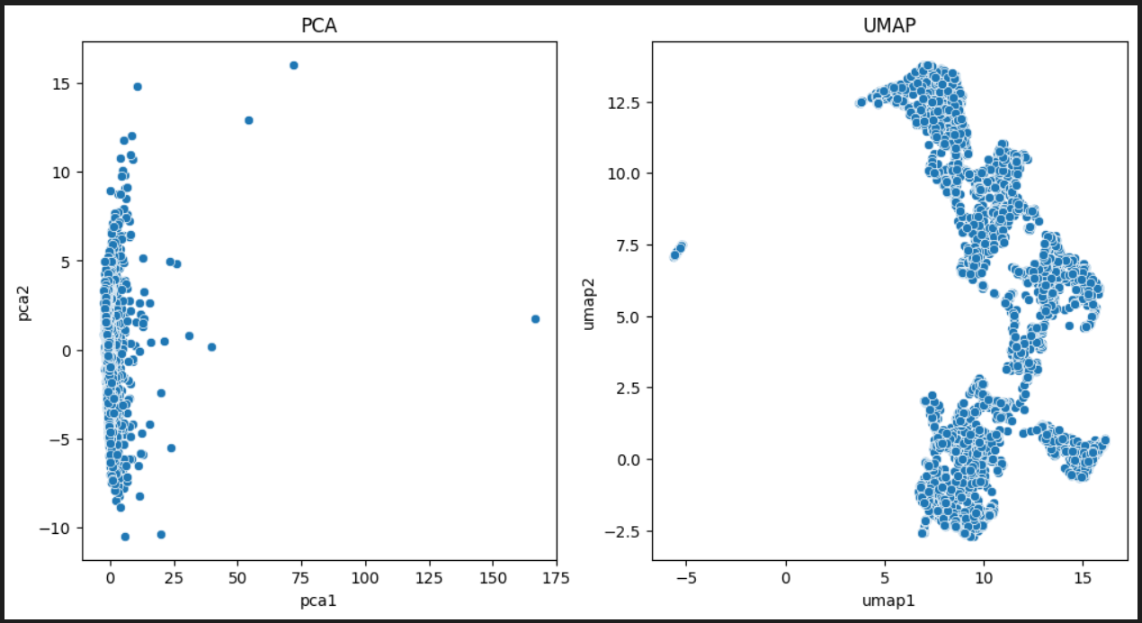
Question One : PCA vs UMAP
It appears that UMAP is generating distinct clusters for the municipalities based on waste produced and urbanization index. In this case, UMAP may be considered as the technique that works better for this specific dataset and analysis.
UMAP (Uniform Manifold Approximation and Projection) is a non-linear dimensionality reduction technique that is known for its ability to capture complex patterns and structures in high-dimensional data. It is particularly effective at preserving both local and global structures in the data, and is often used for visualizing and exploring high-dimensional data in a lower-dimensional space.

Slide 8
Agenda: Task - 2
Dataset: Earphones reviews
TF-IDF matrix and visualizing matrix using UMAP dimensionality reduction technique
Tuning TF-IDF hyperparameters ngram_range and min_df
Tuning UMAP hyperparameters n_neighbors and min_dist
Identifying clusters/subclusters

Slide 9
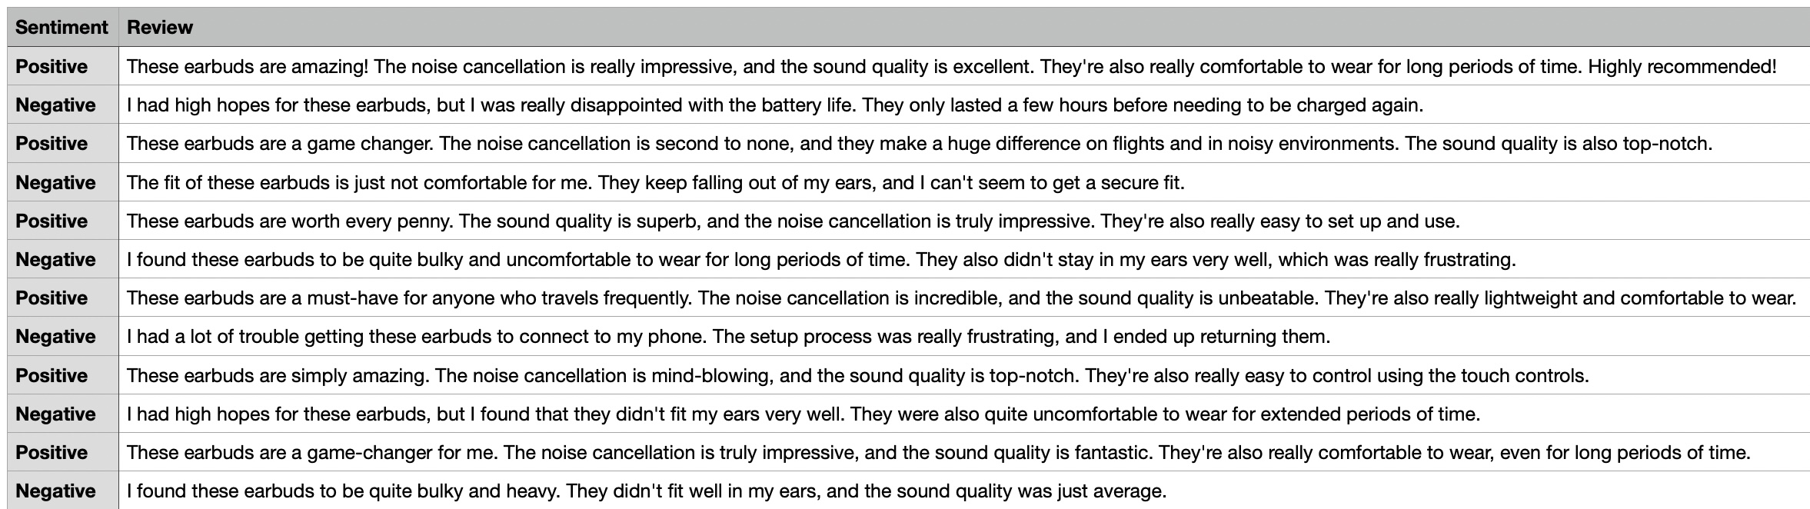
Dataset: Earphone reviews
Data was generated using Open AI ChatGPT for positive and negative reviews of earphones.
Over 1013 unique records were generated and added to Reviews.csv file.
Duplicated records generated by ChatGPT were removed.
Labelled dataset for earphones reviews

Slide 10
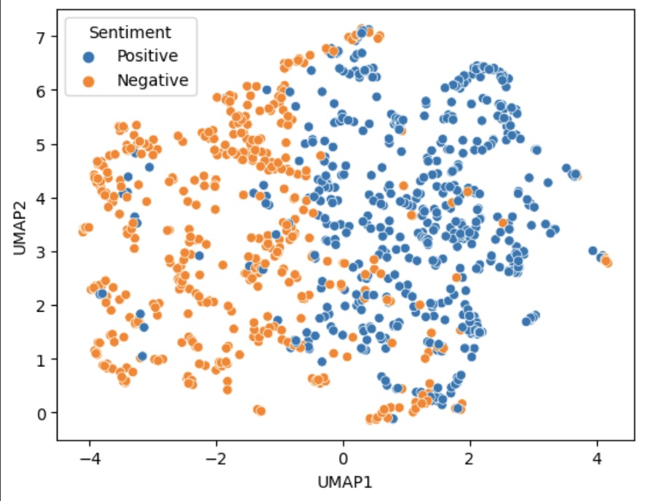
TF-IDF matrix & visualization using UMAP
In this task, using python code we converted the Reviews.csv to TF-IDF matrix and visualized that matrix using UMAP dimensionality reduction technique.
Sklearn, umap and matplolib python packages were used for this task.
As seen below, using matplot we are showing a scatterplot of TF-IDF matrix using UMAP. The color represent the review sentiment (Blue for positive and orange for negative)
Scatterplot for positive and negative earphones reviews

Slide 11
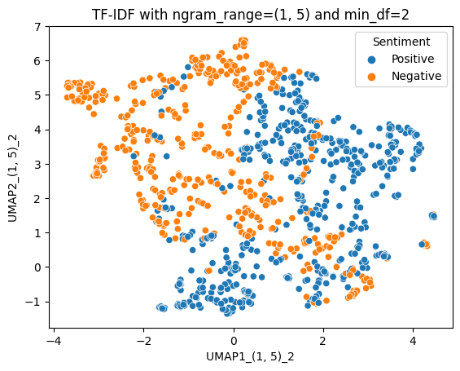
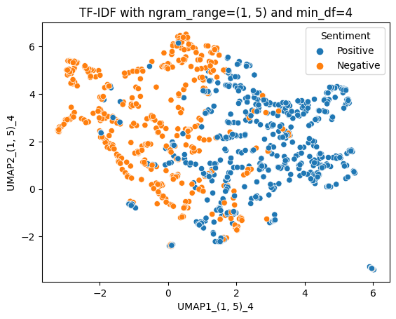
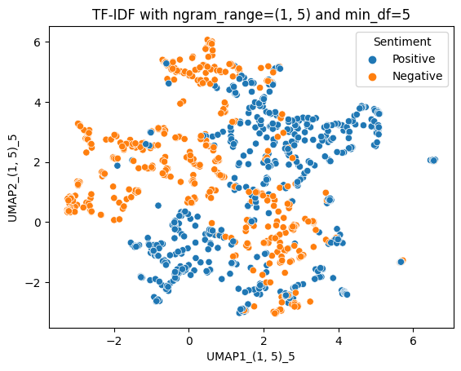
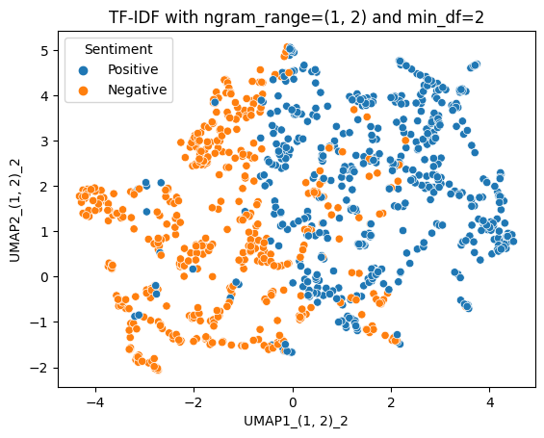
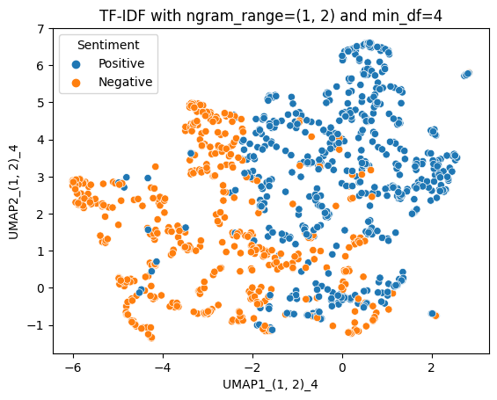
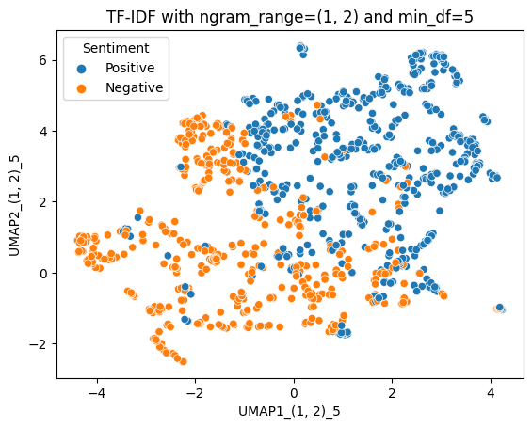
Tuning TF-IDF hyperparameters
In this task, we have tuned the matrix using TF-IDF hyperparameters ngram_range and min_df.
We used the below range for ngrams and frequency for min_df:
Range: ngram_ranges = [(1, 5), (1, 3), (1, 2)]
Frequency: min_dfs = [2, 4, 5]
Increasing value of ngram_range can capture more complex words but will also increase the runtime.
High min_dfs value will result in smaller and a focused matrix.
Comparison between 2 scatterplots for ngram_ranges & min_dfs hyperparameter is shown below
Scatterplot for ngram (1, 5)
Scatterplot for ngram (1, 2)

Slide 12
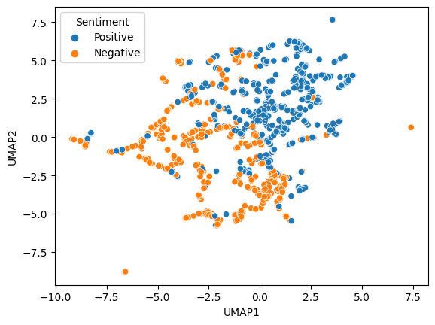
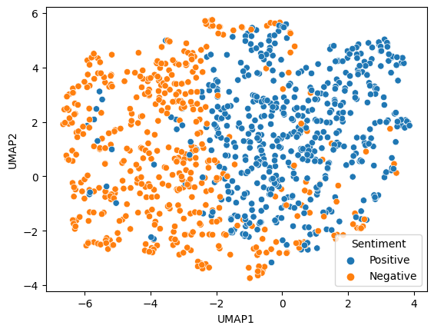
Tuning UMAP hyperparameters
In this task, we have tuned the matrix using UMAP hyperparameters n_neighbors and min_dist.
We used the below parameters for n_neighbors and min_dist:
n_neighbors - 5 & 10
min_dist – 0.1 & 0.4
Increasing value of n_neighbors can result in more connected visualization and nearby points are clustered together.
min_dist determines the distance between points. Setting min_dist low can result in overfitting.
Comparing scatterplots for n_neighbour and min_dist as shown below:
Scatterplot for n_neighbors=5 & min_dist=0.1
Scatterplot for n_neighbors=10 & min_dist=0.4

Slide 13
Identifying clusters/subclusters
Yes, based on the visualization of the TF-IDF matrix using UMAP, we can identify 2 clusters of reviews based on positive (blue) and negative (orange) sentiments of the customers.
The negative reviews (orange) are clustered to the left of scatterplot whereas positive reviews (blue) are to the right of the scatterplot.
No clear visible sub-clusters were identified from the generated scatterplot.

Slide 14
Contributions
Question One :
Data Understanding : Aniket worked on understanding the variables of the municipalities dataset and the same was explained to the group members.
Tableau visualization : Aniket and Vaibhav worked on creating multiple tableau visualizations for municipalities dataset which depicts important insights about the dataset (Waste Management).
PCA : Aniket worked on creating the PCA representation for cluster identification of municipalities dataset.
UMAP : Prathamesh worked on creating UMAP representations for cluster identification of municipalities dataset.
Bug Fixes : Prathamesh and Vaibhav worked on fixing issues with tableau visualizations and errors which occurred in python code.
Question Two :
TF-IDF : Prathamesh worked on tuning the metrics with TF-IDF parameter like ngram_range and min_df.
UMAP : Vaibhav worked on creating UMAP representations for cluster identification of municipalities dataset and also tuned parameters like n_neighbors and min_dist for retrieving different insights.
Bug Fixes : Aniket worked on fixing errors which occurred in python code.
Earphones dataset generation for question two reviews.csv was done by all group members since it produced many duplicate records so had to remove duplicates and create new.

Slide 15
Thank You!

